Slide 1
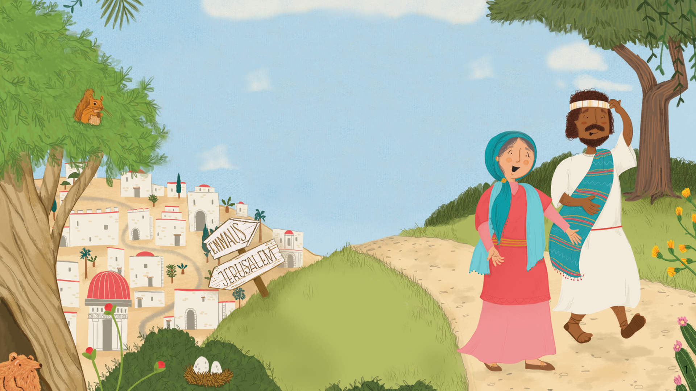
It’s Quiz time!

Slide 2
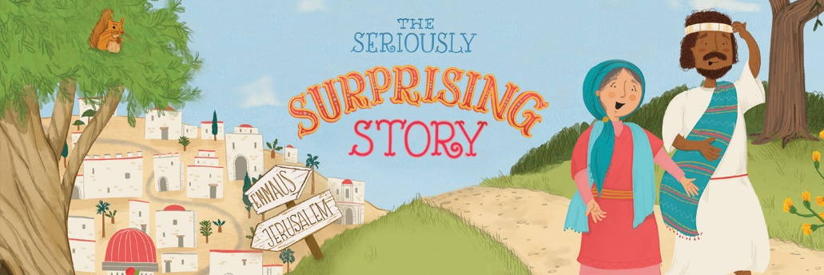

Watch the video

Slide 3
1. What animal ‘scratched their head’ about what’d just been happening?

Slide 4
2. Jesus was from Nazareth. Did the narrator say Nazareth was south, east, west or up north?

Slide 5
3. What miracle was mentioned straight after Jesus turned water into wine?

Slide 6
4. What colour is the crab under Jesus’ feet as he walks on water?

Slide 7
5. How many piles of material could you see folded up in the grave?

Slide 8
6. Noah’s Ark was shown on the scroll – true or false?

Slide 9
7. What image is on the signpost pointing to the place they go to eat in the evening?

Slide 10
8. What was under the dining table when they are looking for Jesus?

Slide 11
9. What book is the mum reading to her child at bedtime?

Slide 12
10. What instruments can you see in the last scene?

Slide 13
Time for the answers…

Slide 14
1. What animal ‘scratched their head’ about what’d just been happening?
A squirrel

Slide 15
2. Jesus was from Nazareth. Did the narrator say Nazareth was south, east, west or up north?
Up north

Slide 16
3. What miracle was mentioned straight after Jesus turned water into wine?
Bringing his friend back to life!

Slide 17
4. What colour is the crab under Jesus’ feet as he walks on water?
Red

Slide 18
5. How many piles of material could you see folded up in the grave?
Three

Slide 19
6. Noah’s Ark was shown on the scroll – true or false?
True

Slide 20
7. What image is on the signpost pointing to the place they go to eat in the evening?
A house

Slide 21
8. What was under the dining table when they are looking for Jesus?
A dog

Slide 22
9. What book is the mum reading to her child at bedtime?
The Seriously Surprising Story

Slide 23
10. What instruments can you see in the last scene?
Guitar and drums

Slide 24
Well done!

